Slide 1
Hi ☺
We are a church in London (UK) who loves Jesus and longs to see more of His young people walking with Him.
To use this simple youth session plan on ‘accepting and loving others despite our flaws’, read the notes at the bottom of each slide. This is where you’ll find teacher/youth leader instructions for the activities onscreen.
God bless you!

Slide 2
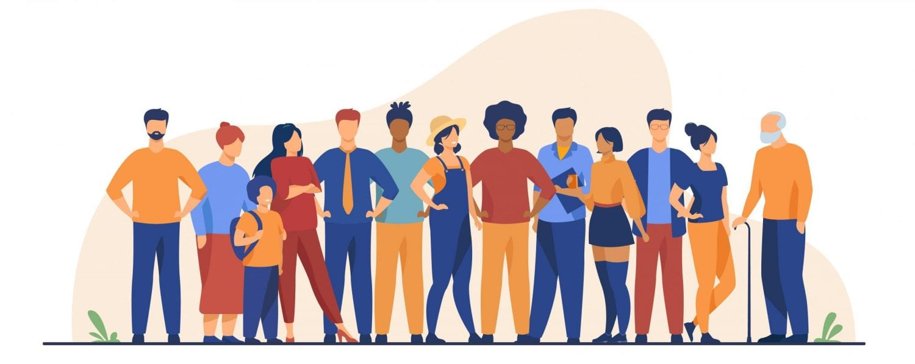
Accepting Others
Notes:
START. Show this title screen AND play the music (see sound icon onscreen) whilst the children enter.

Slide 3
Q:
What’s your least favourite insect?
Notes:
Ice-breaker question for the kids to answer as a warm-up (adults answer too!).

Slide 4
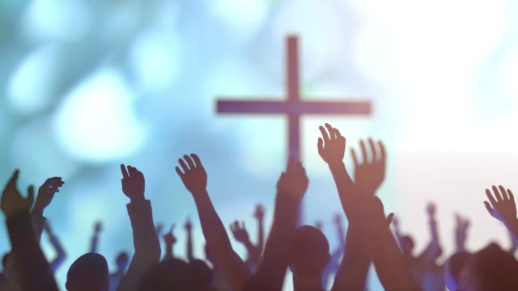
Break Every Chain (There is Power)
Notes:
Worship & reflection song to prepare our hearts and minds for the session. Click button (whilst in slideshow mode) to link to the song on YouTube. Allow the children to watch quietly or listen with their eyes closed if they’re too shy to sing. Encourage them to think about the words (reflect on the lyrics).

Slide 5
Focus Verse
For God loved the world that He gave His Son, that whoever believes in Him shall have eternal life.
John 3:16
Notes:
Take a look at our focus verse. Say: [There’s are bits missing from the verse written on screen. What needs to be added in?] See next slide for the answers.

Slide 6
Focus Verse
For God so loved the world that He gave His one and only Son, that whoever believes in Him shall not perish but have eternal life.
John 3:16
Notes:
Say it aloud together.

Slide 7
Accepting Others
Notes:
Introduce today’s topic.

Slide 8
Challenge
You’ll need:
Plain paper
Pencil
Clipboard
Blindfold
Notes:
Challenge/Game: Choose two volunteers. One volunteer will be blindfolded (and they’ll have the pencil and paper on a clipboard). The other volunteer will instruct them to draw a simple image WITHOUT saying what the image is. The non-blindfolded partner helps the blindfolded partner by giving advice and direction. Play another few rounds with different volunteers if time allows. Examples of simple images for them to draw: smiley face, stick person, tree, cat, chair, phone, flower.

Slide 9
Reflect
Notes:
Say: [In this challenge, both volunteers had a “flaw” they were forced to overcome - one couldn’t see, and the other couldn’t draw. They couldn’t change each other’s “flaws”, just as they couldn’t change their own. Instead, they had to make “allowances” for each other to complete the task.] Discuss with the YP how this sometimes needs to happen in daily life, too. Ask for examples (and have an example ready to share). Close in prayer at the end of the session, encouraging the YP to pray.

