Slide 1
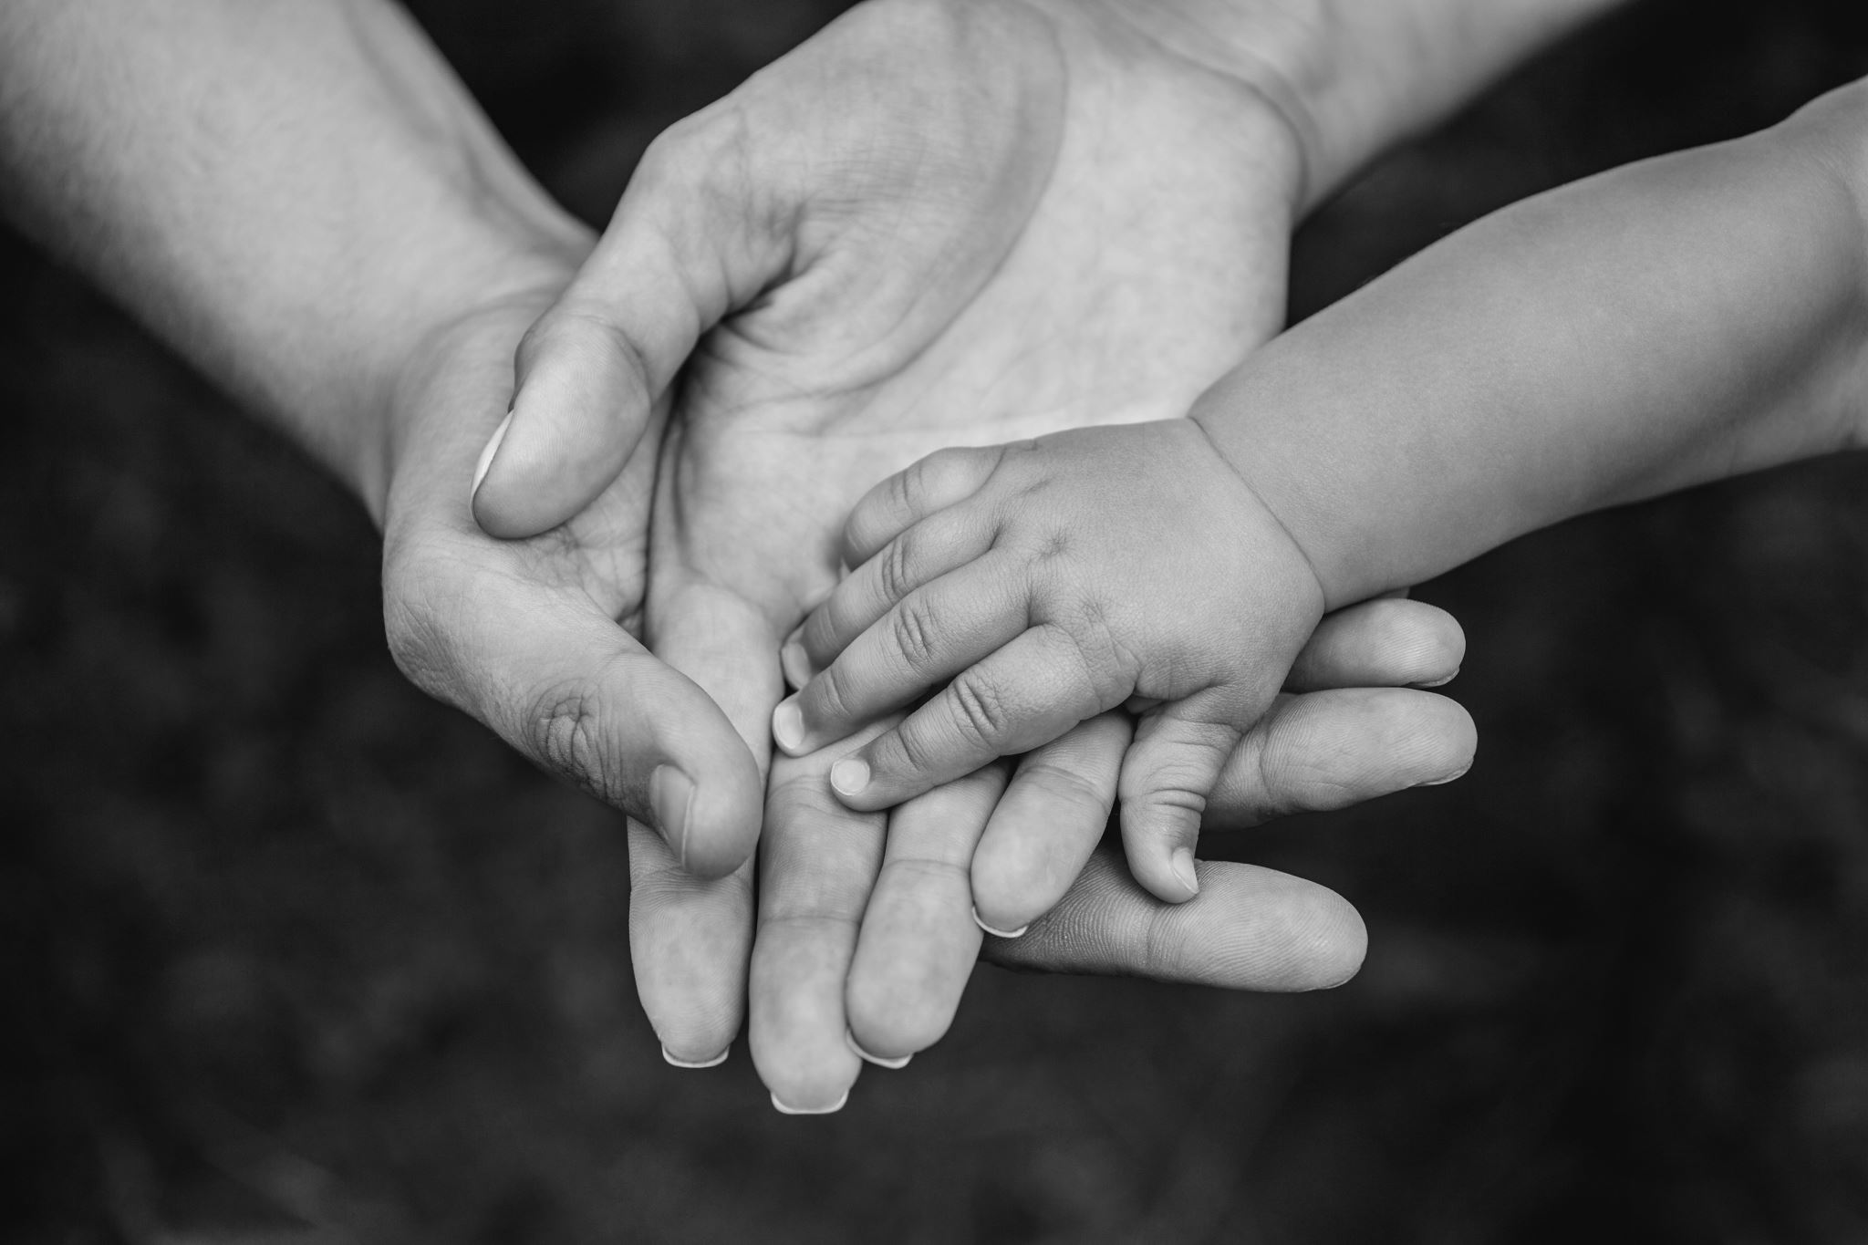
Welcome to
Child Dedication
Class

Slide 2
Introductions
Your Name
How long you have attended Lincoln Berean
What you do during the day
A hobby or something you enjoy
Name of child(ren) being dedicated and one word that you would use to describe them

Slide 3
Child Dedication at Lincoln Berean
Our Vision
Coming together: to know Jesus, become more like Him, and help others do the same.

Slide 4


Slide 5
Child Dedication at Lincoln Berean
Family Milestone
Parents’ Commitment
Not Salvation or Baptism

Slide 6
Biblical Foundation for Child Dedication
Hear, O Israel: The Lord our God, the Lord is one. Love the Lord your God with all your heart and with all your soul and with all your strength. These commandments that I give you today are to be on your hearts. Impress them on your children. Talk about them when you sit at home and when you walk along the road, when you lie down and when you get up. Tie them as symbols on your hands and bind them on your foreheads. Write them on the doorframes of your houses and on your gates.
-Deuteronomy 6:4-9

Slide 7
Biblical Foundation for Child Dedication
When the time came for the purification rites required by the Law of Moses, Joseph and Mary took him to Jerusalem to present him to the Lord (as it is written in the Law of the Lord, ‘Every firstborn male is to be consecrated to the Lord’), and to offer a sacrifice in keeping with what is said in the Law of the Lord: ‘a pair of doves or two young pigeons.’
-Luke 2:22-24

Slide 8
What am I committing to?
Will you commit your child to God, committing to raise them according to God’s Truth and to do all you can to help them come to a saving knowledge of Jesus Christ?
Will you seek to model a relationship with Jesus for your child by passionately pursuing God yourself?
Will you seek to parent with grace and truth so that you can model the loving and caring relationship God desires with them?
Will you commit to regularly pray for your child, that as they grow, they might come to know and do the will of God by the power of the Holy Spirit?

Slide 9
Dedication Day!
What to expect
Arrive 10 minutes before the service starts.
Sit in an area that feels comfortable and preferably close to your spot on the stage.
In the service, a staff member will share a little about Child Dedication and invite you on stage.
  When invited, bring your family and prayer partner(s) with you to the stage.
  Stand in your assigned area.
Staff member will read and have you respond together to the commitments with “I will/We will.”
Staff member will pray and then a slide show of the pictures of your child(ren) and family will be shown.
  During the slide show, your prayer partner will pray for you and your family.
When you are done praying you can return to your seats.

Slide 10
Next Steps After Dedication
After service, you can pick up your child’s dedication certificate and Bible from the spotlight booth in the lobby.
1
Get/keep your child(ren) involved with LBC Kids.
2
Make a memory that you can share with your child each year to celebrate and remember their dedication.
3
Intentionally seek to be in Christian community with other parents.
4
Continue to pursue your own relationship with Jesus and help others do the same.
5

Slide 11

Our Priorities:
- Biblical Focus
- Safety
- Parent Involvement
- Age-appropriate Lessons
- Fun

Slide 12
Things We Need From You!
Photos (send to kids@lincolnberean.org)
Prayer Partners

Slide 13

Questions?

